Slide 1
Cyber Forensics
The Fascinating World of Digital Evidence

Slide 2
INTRODUCTION
the preservation, identification, extraction, documentation, and interpretation of computer media for evidentiary and/or root cause analysis.

Slide 3
DIGITAL FORENSIC
Digital forensics is used to supplement investigations

Slide 4
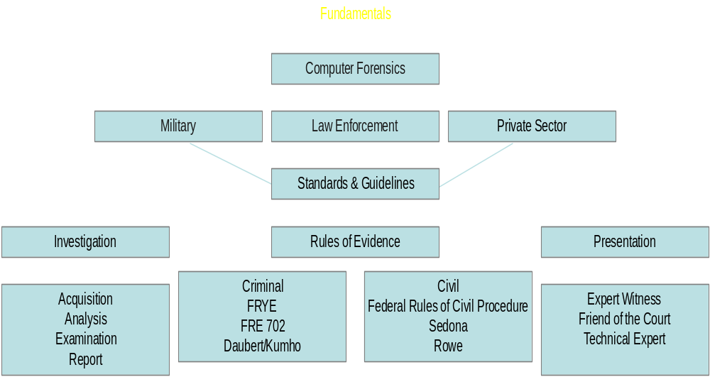
Computer Forensics

Slide 5
Digital Forensic Science
Digital Forensic Science (DFS):
  “The use of scientifically derived and proven methods toward the preservation, collection, validation, identification, analysis, interpretation, documentation and presentation of digital evidence derived from digital sources for the purpose of facilitating or furthering the reconstruction of events found to be criminal, or helping to anticipate unauthorized actions shown to be disruptive to planned operations.”
  Source: (2001). Digital Forensic Research Workshop (DFRWS)
Notes:
On board:
preservation, collection, validation, identification, analysis, interpretation, documentation and presentation

Slide 6

Communities
There at least 3 distinct communities within Digital Forensics
  Law Enforcement
  Military
  Business & Industry
Notes:
List on the board.

Slide 7
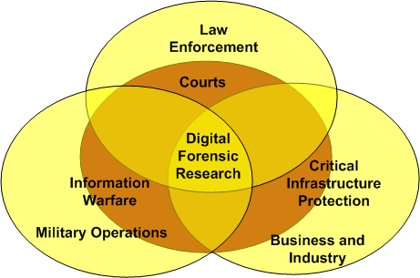
Digital Forensic Science

Slide 8
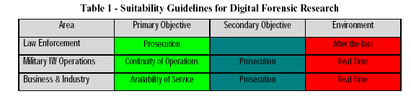
Community Objectives

Slide 9
Cyber Forensics
Includes:
  Networks (Network Forensics)
  Small Scale Digital Devices
  Storage Media (Computer forensics)
  Code Analysis

Slide 10
Cyber Forensics
The scientific examination and analysis of digital evidence in such a way that the information can be used as evidence in a court of law.
Notes:
What are the important components?

Slide 11
Computer Forensic Requirements
Hardware
  Familiarity with all internal and external devices/components of a computer
  Thorough understanding of hard drives and settings
  Understanding motherboards and the various chipsets used
  Power connections
  Memory
BIOS
  Understanding how the BIOS works
  Familiarity with the various settings and limitations of the BIOS

Slide 12
Computer Forensic Requirements (cont)
Operation Systems
  Windows 3.1/95/98/ME/NT/2000/2003/XP
  DOS
  UNIX
  LINUX
  VAX/VMS
Software
  Familiarity with most popular software packages
  such as Office
Forensic Tools
  Familiarity with computer forensic techniques and the software packages that could be used

Slide 13
Handling Evidence
Admissibility of Evidence
  Legal rules which determine whether potential evidence can be considered by a court
  Must be obtained in a manner which ensures the authenticity and validity and that no tampering had taken place
No possible evidence is damaged, destroyed, or otherwise compromised by the procedures used to search the computer
Preventing viruses from being introduced to a computer during the analysis process
Extracted / relevant evidence is properly handled and protected from later mechanical
or electromagnetic damage

Slide 14
Handling Evidence (cont)
Establishing and maintaining a continuing chain of custody
Limiting the amount of time business operations are affected
Not divulging and respecting any ethically [and legally] client-attorney information that is inadvertently acquired during a forensic exploration

Slide 15
Initiating An Investigation
DO NOT begin by exploring files on system randomly
Establish evidence custodian - start a detailed journal with the date and time and date/information discovered
If possible, designate suspected equipment as “off-limits” to normal activity. This includes back-ups, remotely or locally scheduled
house-keeping, and configuration
changes
Collect email, DNS, and other network
service logs

Slide 16
Initiating An Investigation (cont)
Capture exhaustive external TCP and UDP port scans of the host
  Could present a problem if TCP is wrapped
Contact security personnel [CERT], management, Federal and local enforcement, as well as affected sites or persons

Slide 17
Incidence Response
Identify, designate, or become evidence custodian
Review any existing journal of what has been done to system already and/or how intrusion was detected
Begin new or maintain existing journal
Install monitoring tools (sniffers, port detectors, etc.)
Without rebooting or affecting running processes, perform a copy of physical disk
Capture network information

Slide 18
Incidence Response (cont)
Capture processes and files in use (e.g. dll, exe)
Capture config information
Receipt and signing of data

Slide 19
Handling Information
Information and data being sought after and collected in the investigation must be properly handled
Volatile Information
  Network Information
    Communication between system and the network
  Active Processes
    Programs and daemons currently active on the system
  Logged-on Users
    Users/employees currently using system
  Open Files
    Libraries in use; hidden files; Trojans (rootkit) loaded in system

Slide 20
Handling Information (cont)
Non-Volatile Information
  This includes information, configuration settings, system files and registry settings that are available after reboot
  Accessed through drive mappings from system
  This information should investigated and reviewed from a backup copy

Slide 21
Cyber Forensic Activities
Cyber forensics activities commonly include:
  the secure collection of computer data
  the identification of suspect data
  the examination of suspect data to determine details such as origin and content
  the presentation of computer-based information to courts of law
  the application of a country's laws to computer practice.
Notes:
Application of laws very NB. Discuss this.

Slide 22
The 3 As
The basic methodology consists of the 3 As:
  Acquire the evidence without altering or damaging the original
  Authenticate the image
  Analyze the data without modifying it
Notes:
Why are these so importnat

Slide 23
Context of Cyber Forensics
Homeland Security
Information Security
Corporate Espionage
White Collar Crime
Child Pornography
Traditional Crime
Incident Response
Employee Monitoring
Privacy Issues
????
Digital Forensics
Cyber Forensics

Slide 24
Crime Scenes
Physical Crime Scenes vs. Cyber/Digital Crime Scenes
Overlapping principals
The basics of criminalistics are constant across both physical and cyber/digital
Locard’s Principle applies
  “When a person commits a crime something is always left at the scene of the crime that was not present when the person arrived”

Slide 25
Digital Crime Scene
Digital Evidence
  Digital data that establish that a crime has been committed, can provide a link between a crime and its victim, or can provide a link between a crime and the perpetrator (Carrier & Spafford, 2003)
Digital Crime Scene
  The electronic environment where digital evidence can potentially exist (Rogers, 2005)
  Primary & Secondary Digital Scene(s) as well

Slide 26
Forensic Principles
Digital/ Electronic evidence is extremely volatile!
Once the evidence is contaminated it cannot be de-contaminated!
The courts acceptance is based on the best evidence principle
  With computer data, printouts or other output readable by sight, and bit stream copies adhere to this principle.
Chain of Custody is crucial

Slide 27
Cyber Forensic Principles
The 6 Principles are:
    When dealing with digital evidence, all of the general forensic and procedural principles must be applied.
    Upon seizing digital evidence, actions taken should not change that evidence.
    When it is necessary for a person to access original digital evidence, that person should be trained for the purpose.
    All activity relating to the seizure, access, storage or transfer of digital evidence must be fully documented, preserved and available for review.
    An Individual is responsible for all actions taken with respect to digital evidence whilst the digital evidence is in their possession.
    Any agency, which is responsible for seizing, accessing, storing or transferring digital evidence is responsible for compliance with these principles.

Slide 28
Steps Of Computer Forensics
According to many professionals, Computer Forensics is a four (4) step process
  Acquisition
    Physically or remotely obtaining possession of the computer, all network mappings from the system, and external physical storage devices
  Identification
    This step involves identifying what data could be recovered and electronically retrieving it by running various Computer Forensic tools and software
    suites
  Evaluation
    Evaluating the information/data recovered to
    determine if and how it could be used again the
    suspect for employment termination or prosecution
    in court

Slide 29
Steps Of Computer Forensics (cont)
  Presentation
    This step involves the presentation of evidence discovered in a manner which is understood by lawyers, non-technically staff/management, and suitable as evidence as determined by United States and internal laws

Slide 30
Process/Phases
Identification
Collection
  Bag & Tag
Preservation
Examination
Analysis
Presentation/Report

Slide 31
Identification
The first step is identifying evidence and potential containers of evidence
More difficult than it sounds
  Small scale devices
  Non-traditional storage media
  Multiple possible crime scenes

Slide 32












Devices Identification

Slide 33
Identification
Context of the investigation is very important
Do not operate in a vacuum!
Do not overlook non-electronic sources of evidence
  Manuals, papers, printouts, etc.

Slide 34
Collection
Care must be taken to minimize contamination
Collect or seize the system(s)
Create forensic image
  Live or Static?
  Do you own the system
  What does your policy say?

Slide 35
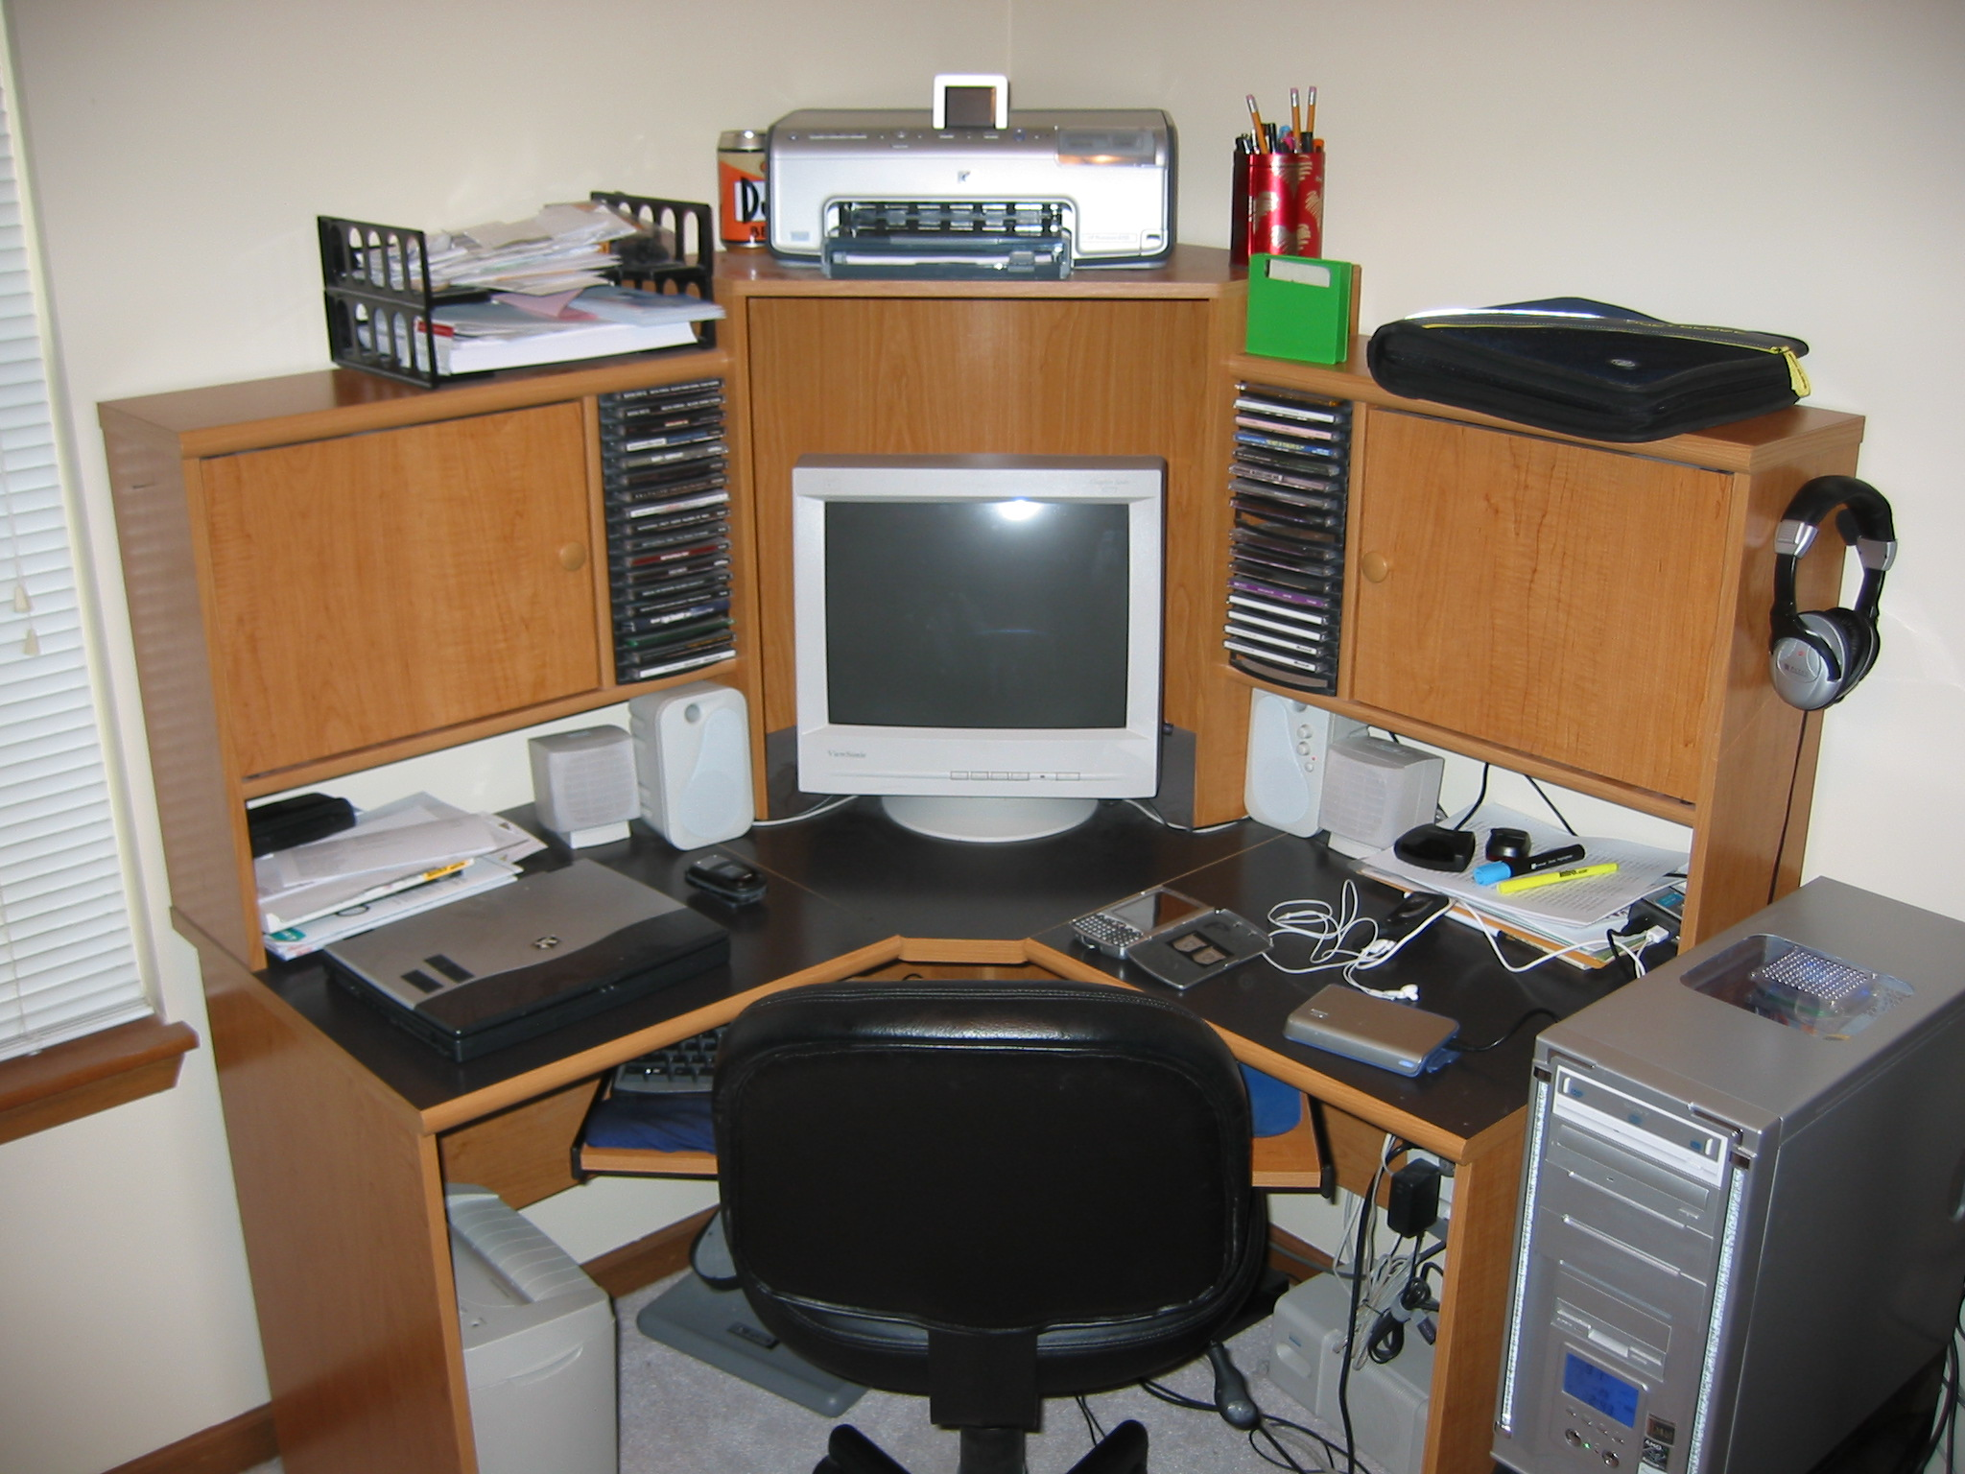

Slide 36
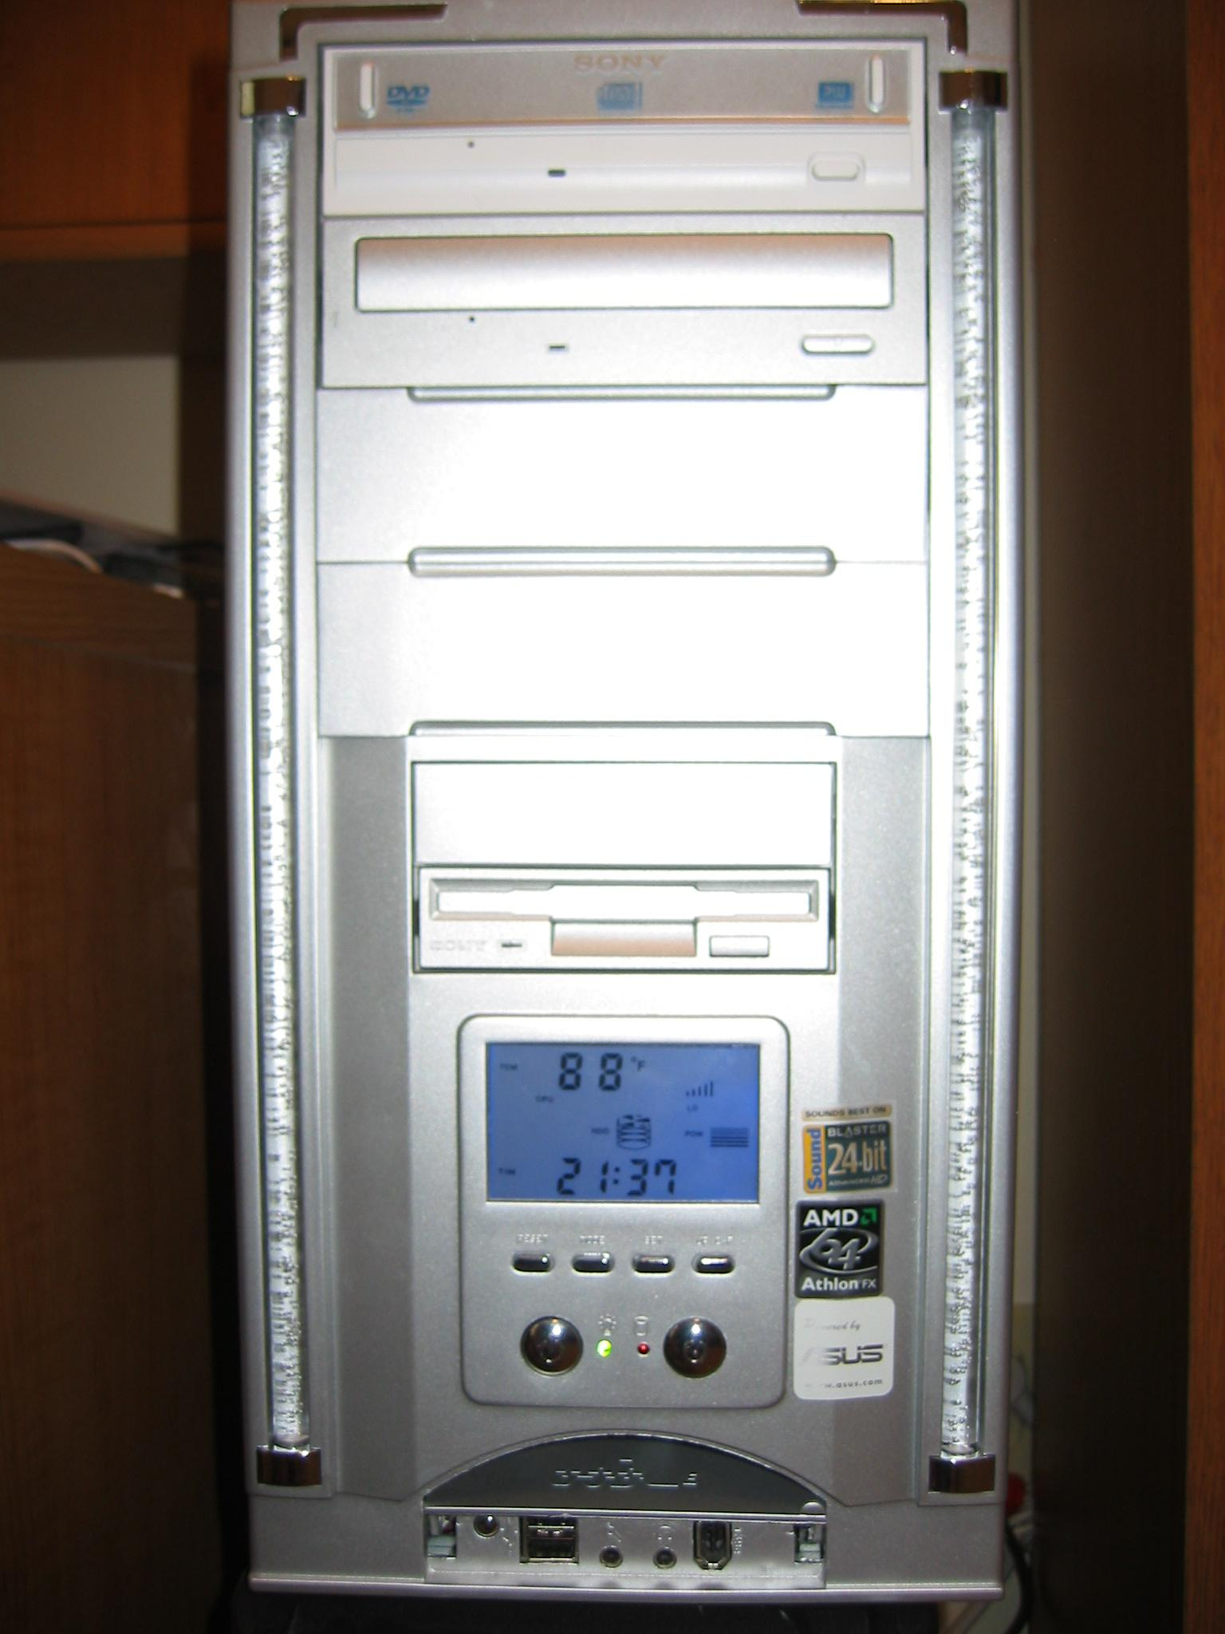
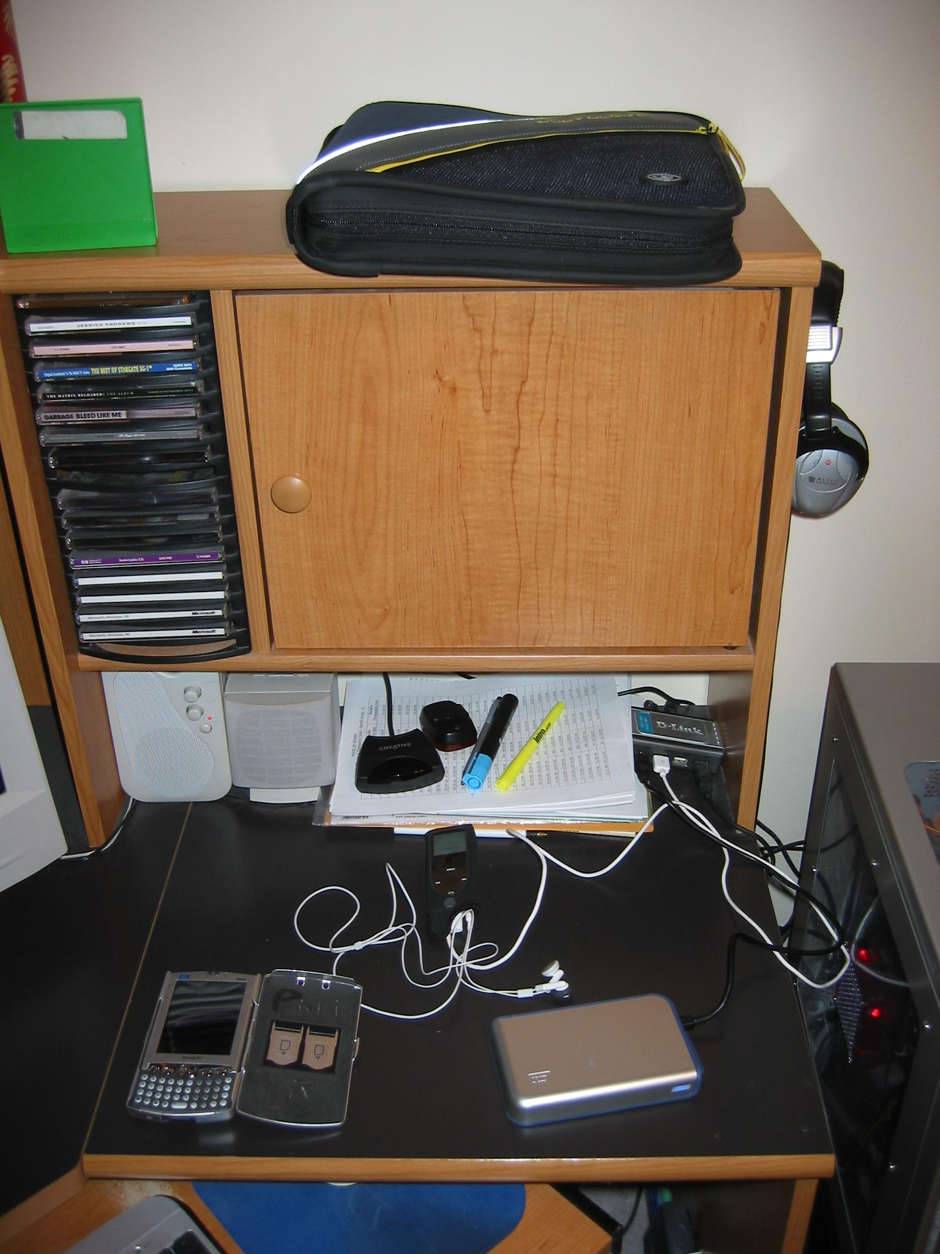
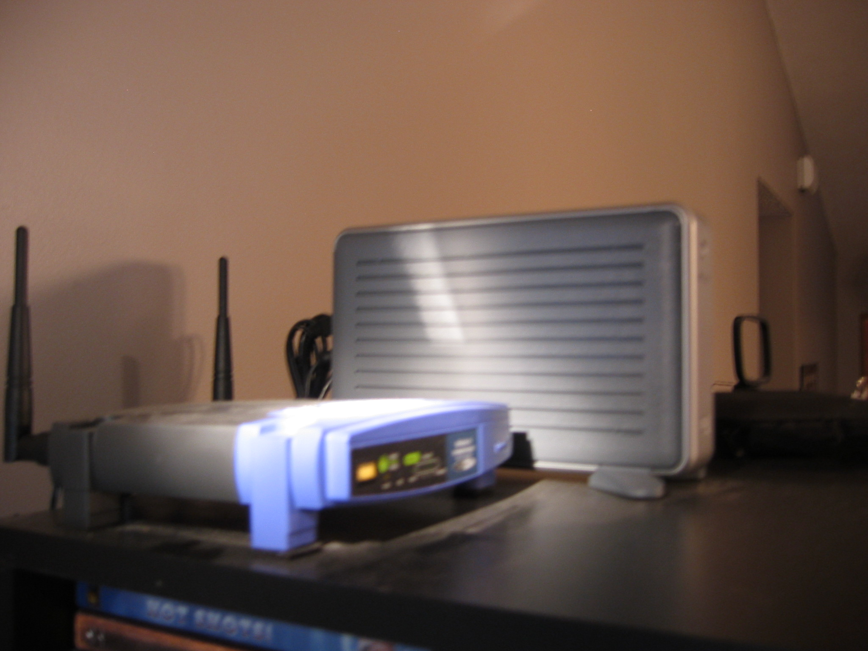
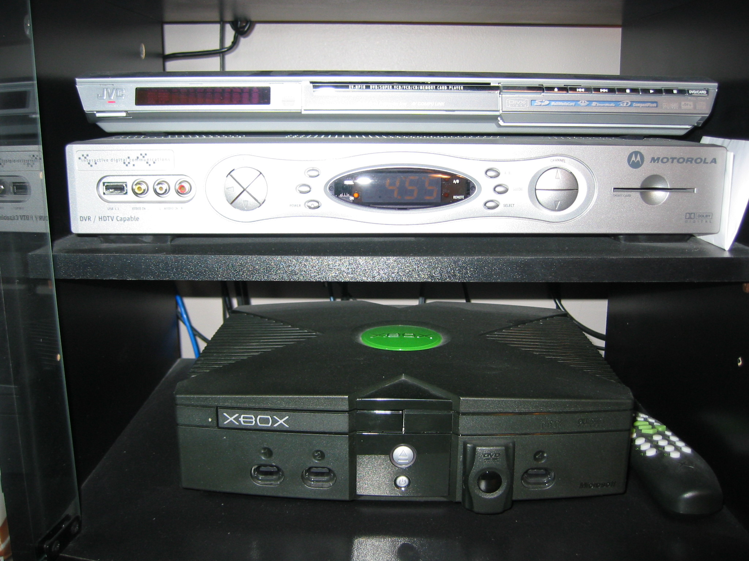
Collection: Documentation

Slide 37
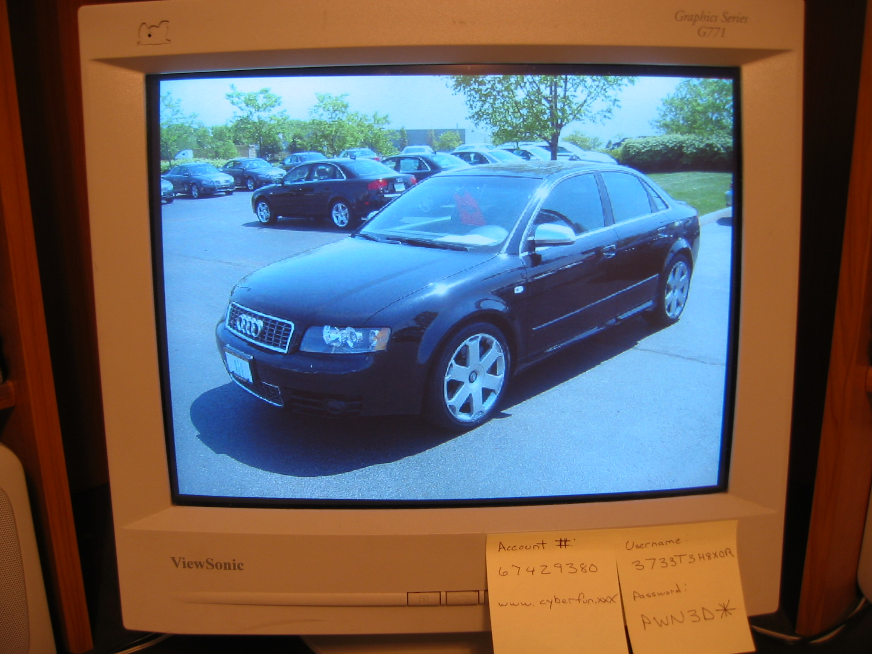
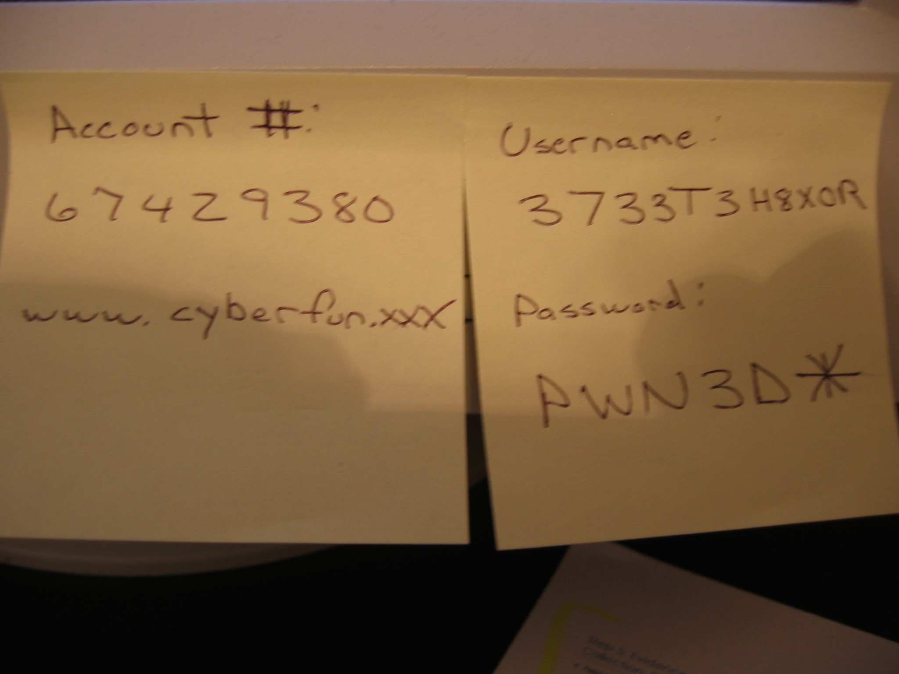
Collection: Documentation
Take detailed photos and notes of the computer / monitor
  If the computer is “on”, take photos of what is displayed on the monitor – DO NOT ALTER THE SCENE

Slide 38
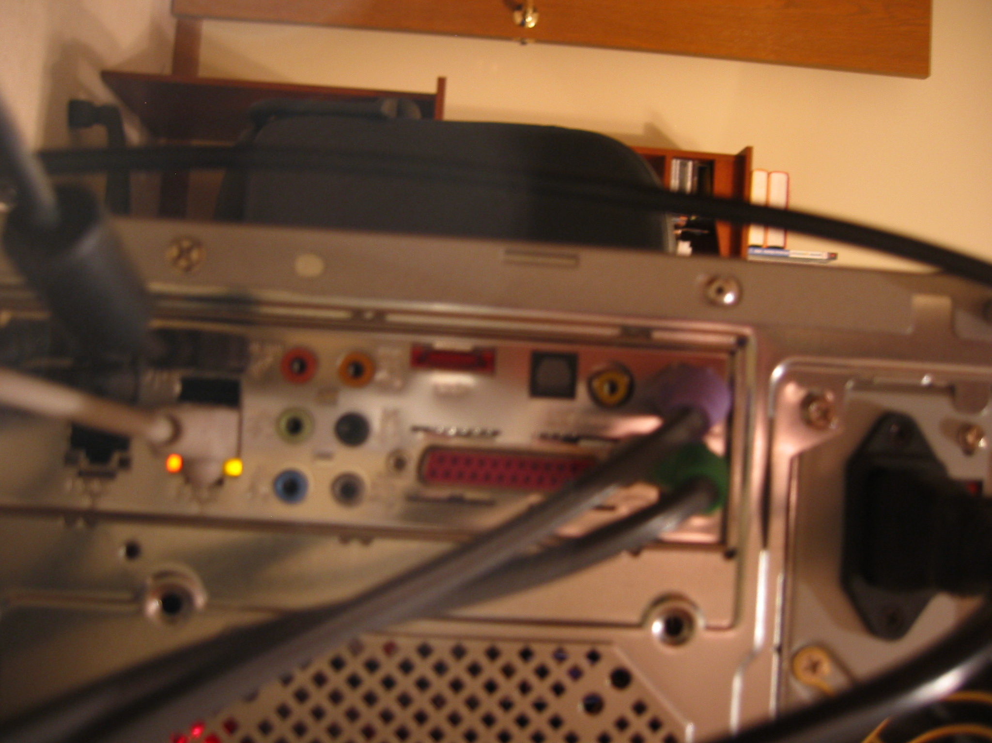
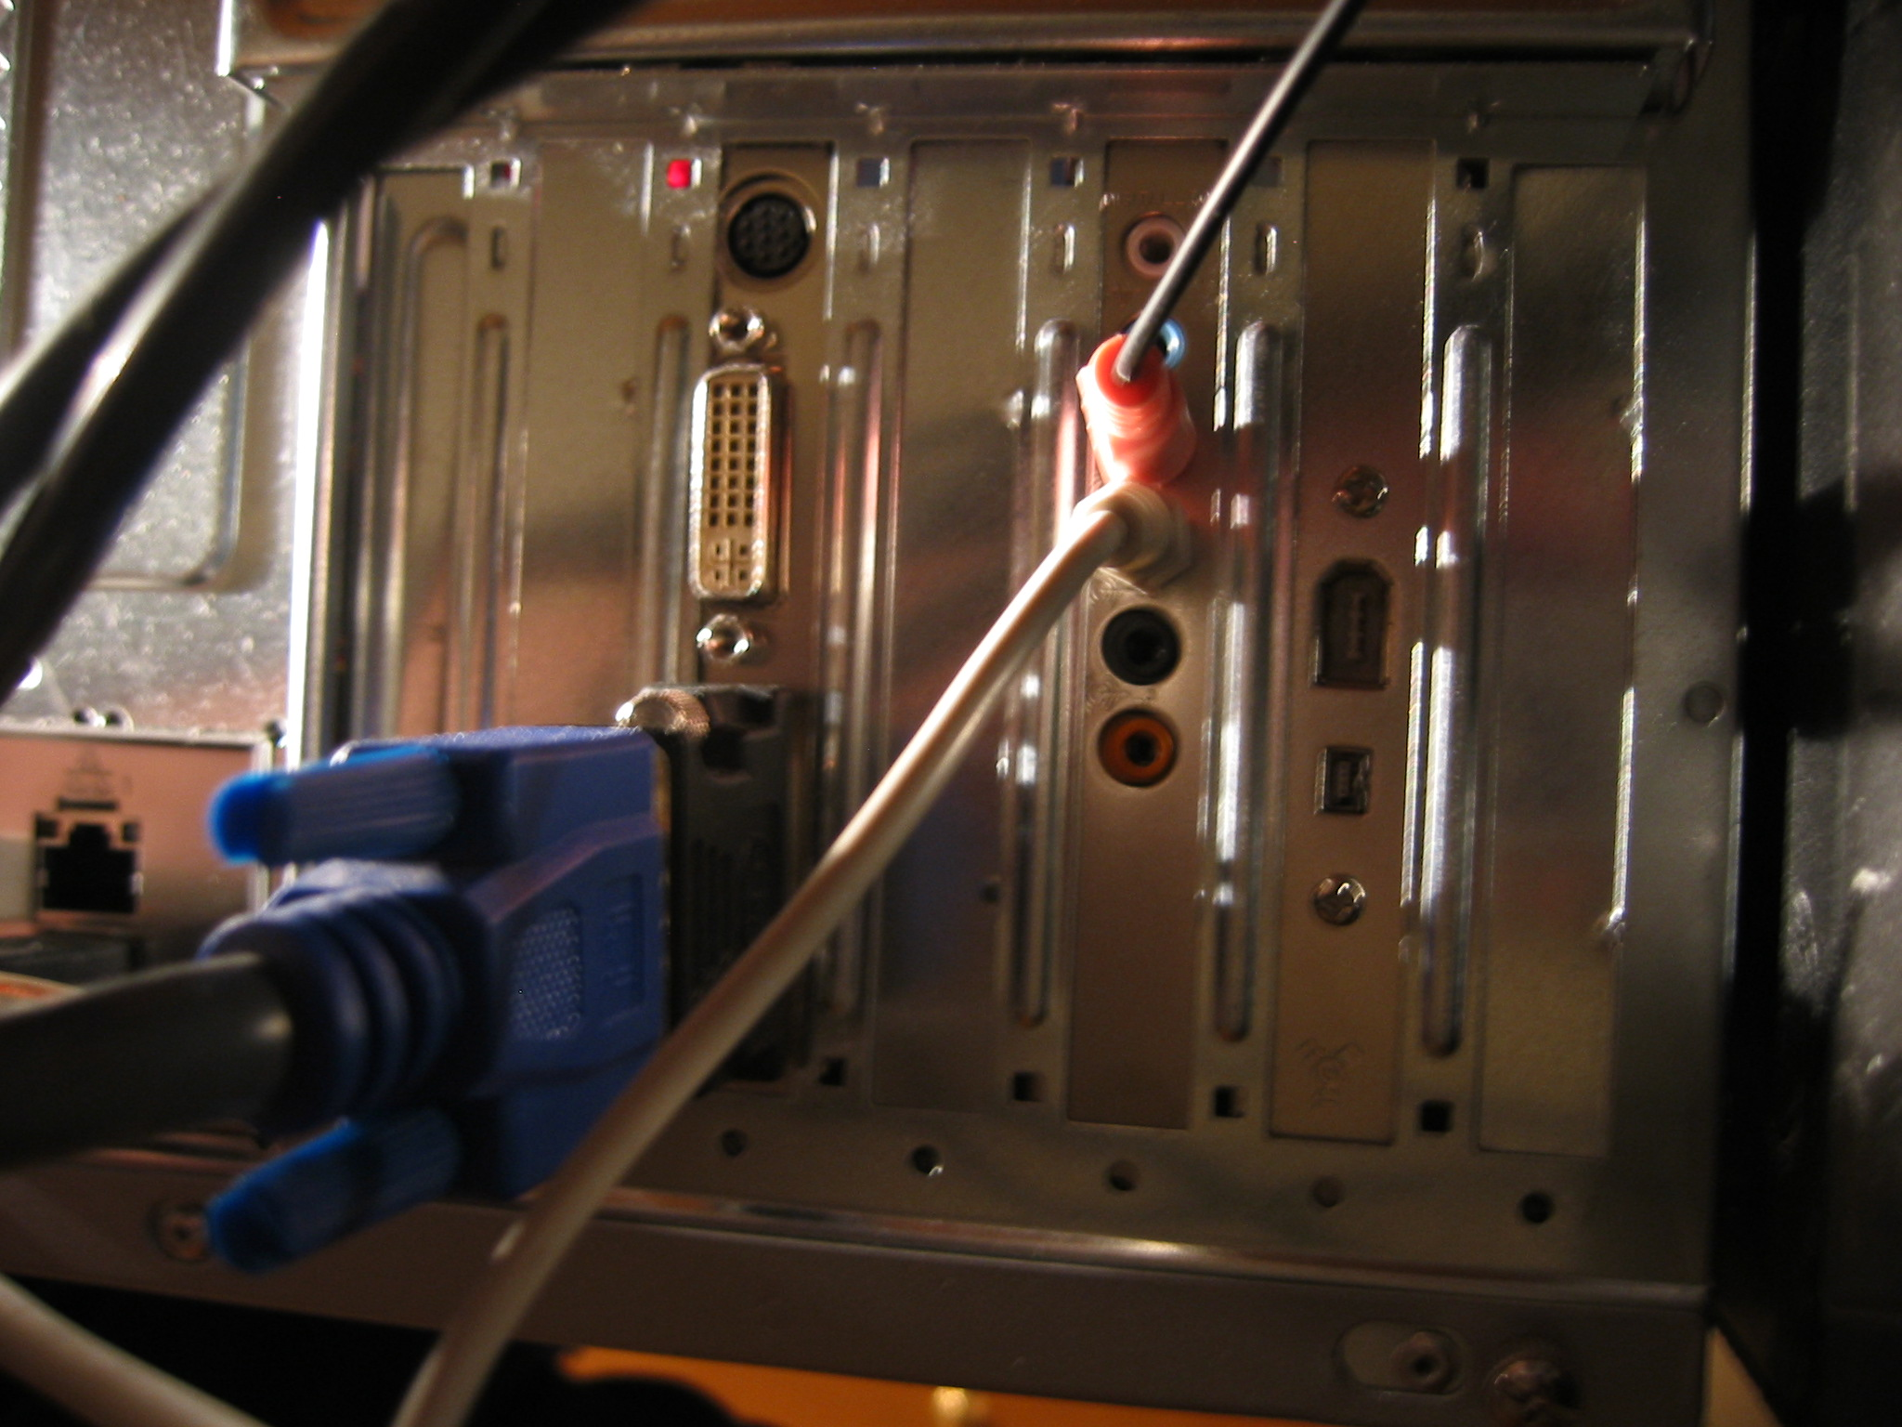
Collection: Documentation
Make sure to take photos and notes of all connections to the computer/other devices

Slide 39
Collection: Imaging
Rule of Thumb: make 2 copies and don’t work from the original (if possible)
A file copy does not recover all data areas of the device for examination
Working from a duplicate image
  Preserves the original evidence
  Prevents inadvertent alteration of original evidence during examination
  Allows recreation of the duplicate image if necessary
Notes:
Never do anything that might inadvertently cause something to be written to the suspect’s original media.

Slide 40
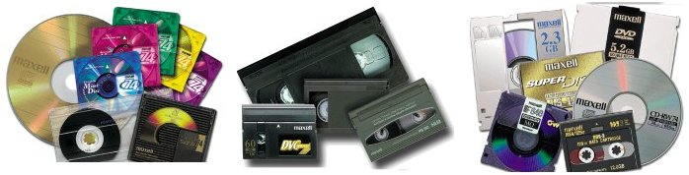
Collection: Imaging
Digital evidence can be duplicated with no degradation from copy to copy
  This is not the case with most other forms of evidence
Notes:
Whether analyzed on site or taken to the lab, it is essential to protect the integrity of the data.
A duplicate image, also known as a bit-copy, image, or clone, is an exact, bit-for-bit copy of the source media.
A duplicate image of a physical device will be a true, digital copy of the entire physical device, including partition tables, reserved areas, partitions and unused areas of the device.
A duplicate image of a logical drive will be a bit-for-bit copy of the original logical drive, including Boot Record, FATs, Root Directory, Data Area, and Partition Slack.

Slide 41
Collection: Imaging
Write blockers
  Software
  Hardware
Hardware write blockers are becoming the industry standard
  USB, SATA, IDE, SCSI, SIM, Memory Cards
  Not BIOS dependent
  But still verify prior to usage!

Slide 42
Collection: Imaging
Forensic Copies (Bitstream)
  Bit for Bit copying captures all the data on the copied media including hidden and residual data (e.g., slack space, swap, residue, unused space, deleted files etc.)
Often the “smoking gun” is found in the residual data.
Imaging from a disk (drive) to a file is becoming the norm
  Multiple cases stored on same media
  No risk of data leakage from underlying media
Remember avoid working for original
Use a write blocker even when examining a copy!

Slide 43
Imaging: Authenticity & Integrity
How do we demonstrate that the image is a true unaltered copy of the original?
-Hashing (MD5, SHA 256)
A mathematical algorithm that produces a unique value (128 Bit, 512 Bit)
  Can be performed on various types of data (files, partitions, physical drive)
The value can be used to demonstrate the integrity of your data
  Changes made to data will result in a different value
The same process can be used to demonstrate the image has not changed from time-1 to time-n
Notes:
Developed in 1994, MD5 is a one-way hash algorithm that takes any length of data and produces a 128 bit value, that is a “fingerprint” or “message digest”. This value is “non-reversible”; it is “computationally infeasible” to determine the data based on the value. This means someone cannot figure out your data based on its MD5 value. Here is an example of a MD5 output for the data area:
Processing Data Area: sectors 3246-1648013
MD5 Checksum for: Data Area = 945df74c54de310690e17487d6203876
The actual value is 945df74c54de310690e17487d6203876
A mathematical algorithm was applied to the "Data area" to produce the value (to learn the mathematical details about the algorithm, check out RFC 1321 at http://www.cis.ohio-state.edu/rfc/rfc1321.txt.) Every time an MD5 hash is performed on the data area, it should result in the exact same value. If a different value is obtained, then the data area has been altered.
Source: www.enteract.com/~lspitz/md5.html
Definitions
Hash — A hash value (or simply hash) is a number generated from a string of data. The hash is substantially smaller than the data itself, and is generated by a formula in such a way that it is extremely unlikely that some other data will produce the same hash value.
One-way hash function — An algorithm that turns data into a fixed string of digits, usually for security or data management purposes. The "one way" means that it's nearly impossible to derive the original data from the string.
Message Digest (MD) — The representation of data in the form of a single string of digits, created using a formula called a one-way hash function.
Algorithm — A formula or set of steps for solving a particular problem. To be an algorithm, a set of rules must be unambiguous and have a clear stopping point.

Slide 44
Examination
Higher level look at the file system representation of the data on the media
Verify integrity of image
  MD5, SHA1 etc.
Recover deleted files & folders
Determine keyword list
  What are you searching for
Determine time lines
  What is the timezone setting of the suspect system
  What time frame is of importance
  Graphical representation is very useful

Slide 45
Examination
Examine directory tree
  What looks out of place
  Stego tools installed
  Evidence Scrubbers
Perform keyword searches
  Indexed
  Slack & unallocated space
Search for relevant evidence types
  Hash sets can be useful
  Graphics
  Spreadsheets
  Hacking tools
  Etc.
Look for the obvious first
When is enough enough??

Slide 46
Issues
lack of certification for tools
Lack of standards
lack of certification for professionals
lack of understanding by Judiciary
lack of curriculum accreditation
Rapid changes in technology!
Immature Scientific Discipline

Slide 47
Evidence Processing Guidelines
New Technologies Inc. recommends following 16 steps in processing evidence
They offer training on properly handling each step
  Step 1: Shut down the computer
    Considerations must be given to volatile information
    Prevents remote access to machine and destruction of evidence (manual or ant-forensic software)
  Step 2: Document the Hardware Configuration
  of The System
    Note everything about the computer configuration
    prior to re-locating

Slide 48
Evidence Processing Guidelines (cont)
  Step 3: Transport the Computer System to A Secure Location
    Do not leave the computer unattended unless it is locked in a secure location
  Step 4: Make Bit Stream Backups of Hard Disks and Floppy Disks
  Step 5: Mathematically Authenticate Data on All Storage Devices
    Must be able to prove that you did not alter
    any of the evidence after the computer
    came into your possession
  Step 6: Document the System Date and Time
  Step 7: Make a List of Key Search Words
  Step 8: Evaluate the Windows Swap File

Slide 49
Evidence Processing Guidelines (cont)
  Step 9: Evaluate File Slack
    File slack is a data storage area of which most computer users are unaware; a source of significant security leakage.
  Step 10: Evaluate Unallocated Space (Erased Files)
  Step 11: Search Files, File Slack and Unallocated Space for Key Words
  Step 12: Document File Names, Dates and Times
  Step 13: Identify File, Program and Storage
  Anomalies
  Step 14: Evaluate Program Functionality
  Step 15: Document Your Findings
  Step 16: Retain Copies of Software Used

Slide 50
Methods Of Hiding Data
Covert Channels – Hiding in Transmission
  Take advantage of timing or shared storage to pass data through unsuspected channel
EXAMPLE: IP datagram – Header Redundancy
  Known Maximum Transfer Unit (MTU)
    A datagram (IP) is encapsulated into frame (header, datagram, trailer). MTU is the max total size of this datagram.
    To make IP independent of physical network, MTU = 65,535 bytes to give it more efficiency.
    If the physical layer doesn’t support that MTU, the datagram must be fragmented

Slide 51
Methods Of Hiding Data (cont)
EXAMPLE: Continued…
  Flags: 3 bits
    1st bit: reserved (always 0)
    2nd bit: Do not fragment (DF): if 1, can’t be fragmented. If it is too large to pass through any available physical network, it is discarded
    3rd bit: More fragment (MF): if 1, the datagram is not the last fragment of the original datagram, if 0, it is last one or there is only 1 fragment (the original datagram)

Slide 52
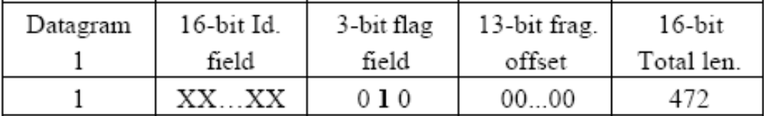
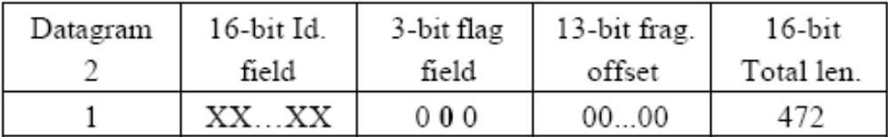
Methods Of Hiding Data (cont)
EXAMPLE – TCP/IP Continued…
  An un-fragmented datagram has all 0’s in the flag fields
    Redundancy condition: the DF bit can be 1 or 0 if no fragment
    From network perspective: Datagram 1 is not allowed to fragment (1 bit), datagram 2 is allowed but does not because it is under the maximum MTU size.

Slide 53
Methods Of Hiding Data (cont)
To human eyes, data usually contains known forms, like images, e-mail, sounds, and text. Most Internet data naturally includes gratuitous headers, too. These are media exploited using new controversial logical encodings: steganography and marking.
Steganography: The art of storing information in such a way that the existence of the information is hidden.

Slide 54
Methods Of Hiding Data (cont)
To human eyes, data usually contains known forms, like images, e-mail, sounds, and text. Most Internet data naturally includes gratuitous headers, too. These are media exploited using new controversial logical encodings: steganography and marking.
The duck flies at midnight. Tame uncle Sam
  Simple but effective when done well

Slide 55
Methods Of Hiding Data (cont)
Watermarking: Hiding data within data
  Information can be hidden in almost any file format.
  File formats with more room for compression are best
    Image files (JPEG, GIF)
    Sound files (MP3, WAV)
    Video files (MPG, AVI)
  The hidden information may be encrypted, but not necessarily
  Numerous software applications will do this for you: Many are freely available online

Slide 56
Methods Of Hiding Data (cont)
Hard Drive/File System manipulation
  Slack Space is the space between the logical end and the physical end of file and is called the file slack. The logical end of a file comes before the physical end of the cluster in which it is stored. The remaining bytes in the cluster are remnants of previous files or directories stored in that cluster.
    Slack space can be accessed and written to directly using a hex editor.
    This does not add any “used space” information to the drive
  Partition waste space is the rest of the unused track which the boot sector is stored on – usually 10s, possibly 100s of sectors skipped
    After the boot sector, the rest of the track is left empty

Slide 57
Methods Of Hiding Data (cont)
Hard Drive/File System manipulation cont…
  Hidden drive space is non-partitioned space in-between partitions
    The File Allocation Table (FAT) is modified to remove any reference to the non-partitioned space
    The address of the sectors must be known in order to read/write information to them
  Bad sectors occur when the OS attempts to read info from a sector unsuccessfully. After a (specified) # of unsuccessful tries, it copies (if possible) the information to another sector and marks (flags) the sector as bad so it is not read from/written to again
    users can control the flagging of bad sectors
    Flagged sectors can be read to /written from with direct reads and writes using a hex editor

Slide 58
Methods Of Hiding Data (cont)
Hard Drive/File System manipulation cont…
  Extra Tracks: most hard disks have more than the rated # of tracks to make up for flaws in manufacturing (to keep from being thrown away because failure to meet minimum #).
    Usually not required or used, but with direct (hex editor) reads and writes, they can be used to hide/read data
  Change file names and extensions – i.e. rename a .doc file to a .dll file

Slide 59
Methods Of Hiding Data (cont)
Other Methods
  Manipulating HTTP requests by changing (unconstrained) order of elements
    The order of elements can be preset as a 1 or 0 bit
    No public software is available for use yet, but the government uses this method for its agents who wish to transfer sensitive information online
    Undetectable because there is no standard for the order of elements and it is, in essence, just normal web browsing
  Encryption: The problem with this is that existence of data is not hidden, instead it draws attention to itself.
    With strong enough encryption, it doesn’t matter if its existence is known

Slide 60
Methods Of Detecting/Recovering Data
Steganalysis - the art of detecting and decoding hidden data
  Hiding information within electronic media requires alterations of the media properties that may introduce some form of degradation or unusual characteristics
  The pattern of degradation or the unusual characteristic of a specific type of steganography method is called a signature
  Steganalysis software can be trained to look for a signature

Slide 61
Methods Of Detecting/Recovering Data (cont)
Steganalysis Methods - Detection
  Human Observation
    Opening a text document in a common word processor may show appended spaces and “invisible” characters
    Images and sound/video clips can be viewed or listened to and distortions may be found
      Generally, this only occurs if the amount of data hidden inside the media is too large to be successfully hidden within the media (15% rule)
  Software analysis
    Even small amounts of processing can filter out echoes and shadow noise within an audio file to search for hidden information
    If the original media file is available, hash values can easily detect modifications

Slide 62
Methods Of Detecting/Recovering Data (cont)
Steganalysis Methods – Detection cont...
  Disk analysis utilities can search the hard drive for hidden tracks/sectors/data
  RAM slack is the space from the end of the file to the end of the containing sector. Before a sector is written to disk, it is stored in a buffer somewhere in RAM. If the buffer is only partially filled with information before being committed to disk, remnants from the end of the buffer will be written to disk. In this way, information that was never "saved" can be found in RAM slack on disk.
  Firewall/Routing filters can be applied to search for hidden or invalid data in IP datagram headers

Slide 63
Methods Of Detecting/Recovering Data (cont)
Steganalysis Methods – Detection cont...
  Statistical Analysis
    Most steganographic algorithms that work on images assume that the Least Significant Bit (LSB) is random
    If a filter is applied to an image, the LSB bits will produce a recognizable image, so the assumption is wrong
    After inserting hidden information into an image, the LSB is no longer non-random (especially with encrypted data). If you apply the same filter, it will no longer produce a recognizable image
    Statistical analysis of the LSB will tell you if the LSB bits are random or not
    Can be applied to audio files as well (using LSB)
  Frequency scanning
    Software can search for high, inaudible frequencies

Slide 64
Methods Of Detecting/Recovering Data (cont)
Steganalysis Methods – Recovery
  Recovery of watermarked data is extremely hard
    Currently, there are very few methods to recover hidden, encrypted data.
  Data hidden on disk is much easier to find. Once found, if unencrypted, it is already recovered
  Deleted data can be reconstructed (even on hard drives that have been magnetically wiped)
  Check swap files for passwords and encryption keys which are stored in the clear (unencrypted)
  Software Tools
    Scan for and reconstruct deleted data
    Break encryption
    Destroy hidden information (overwrite)

